Slide 1
Budget Sales analysis
-by Roshani singh(umip8844)

Slide 2
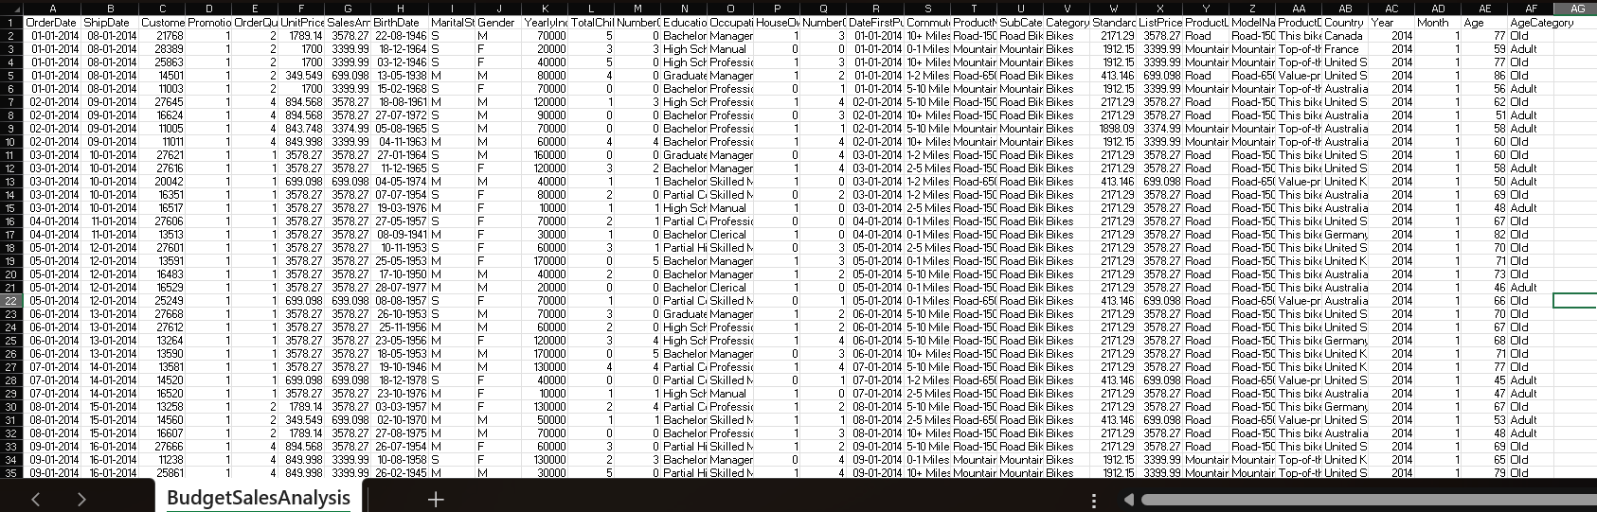
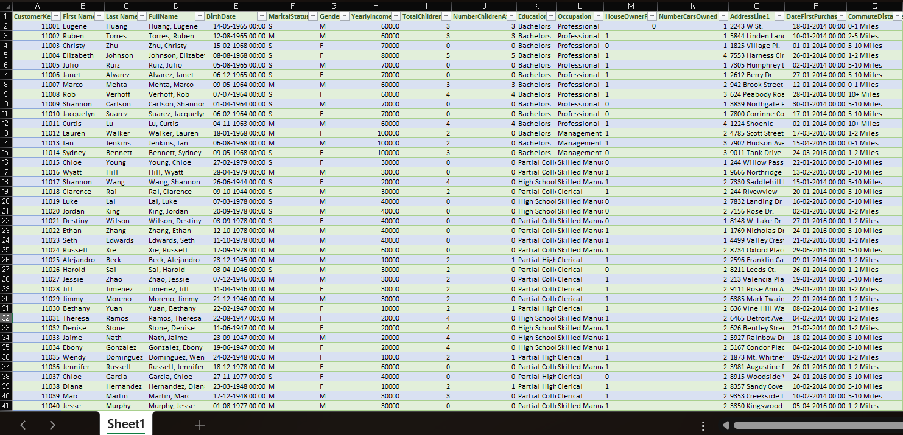
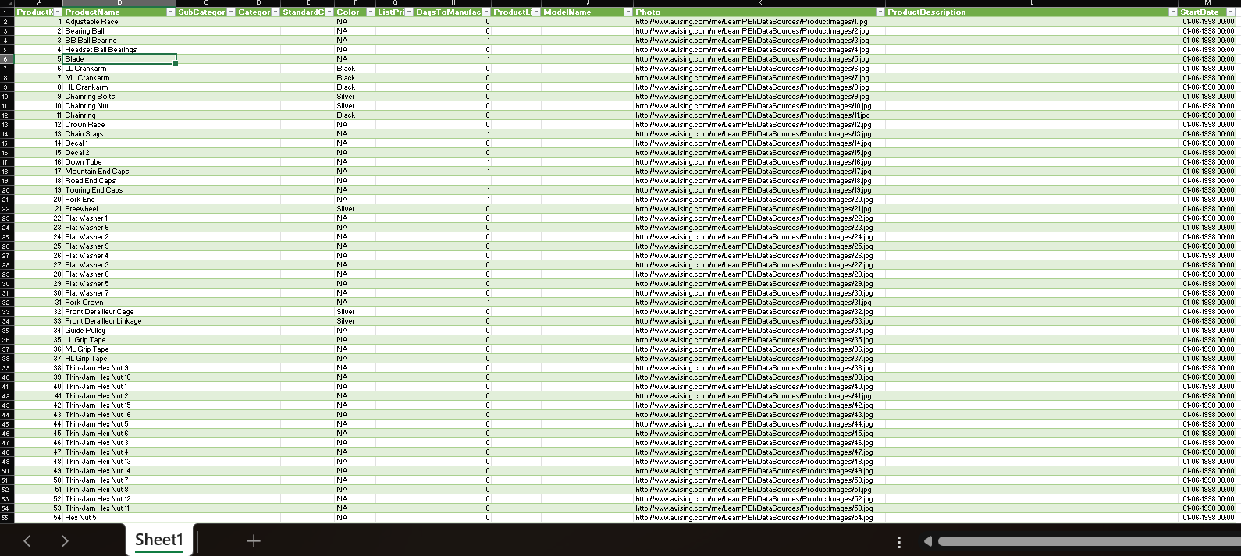
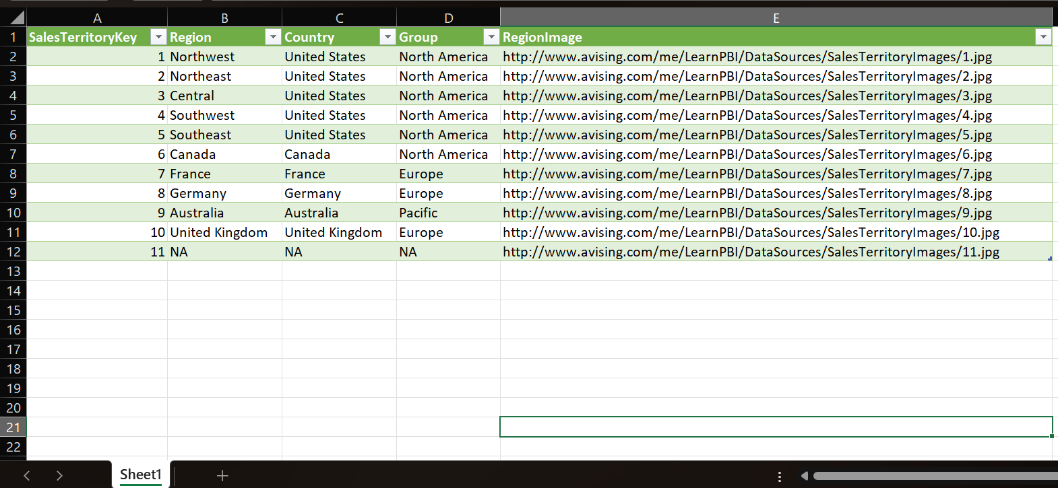
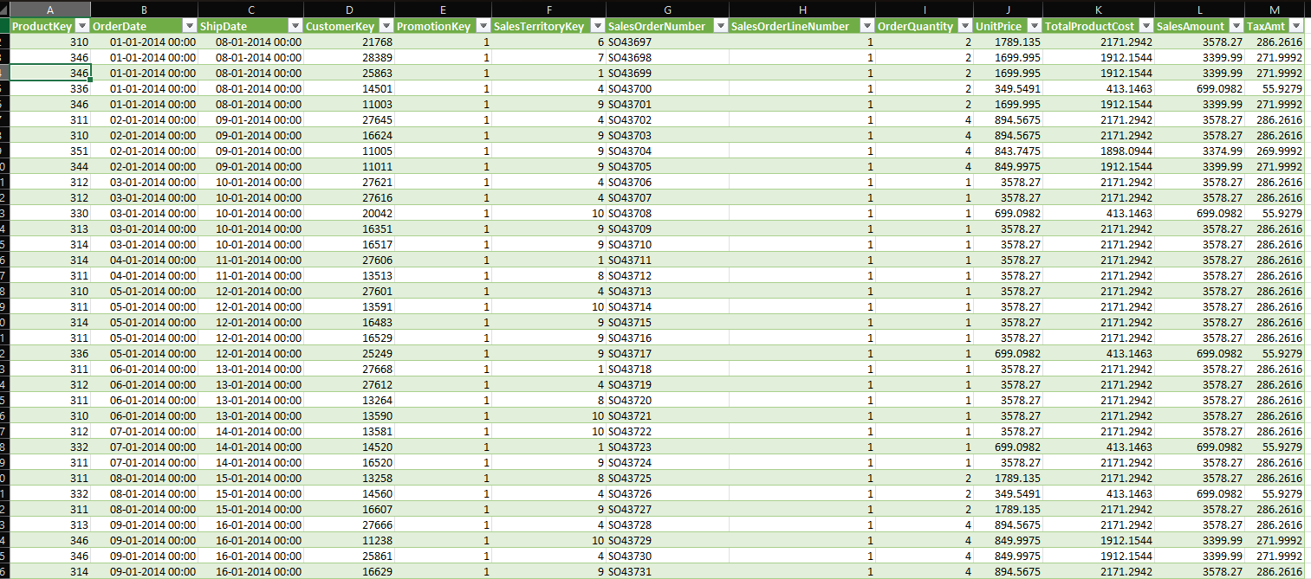
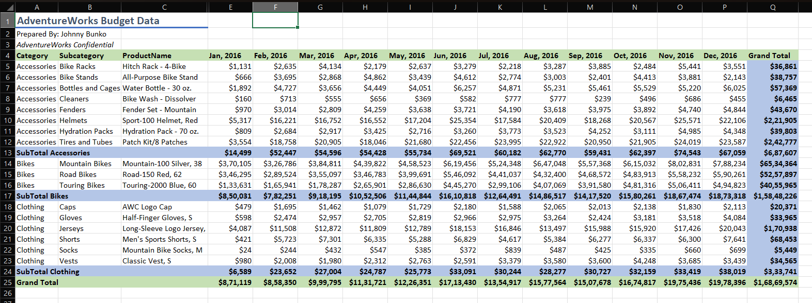
Given Dataset

Slide 3
Dataset Information
This dataset contains various tables:
Budget Data: Contains the features of the sales of budget year 2016.
Customer Data: Contains features regarding the customers.
Sales Data: Contains the features regarding the sales of the products.
Territory Data: Contains the features of the territory of the sales.
Product Data: Contains the features of the products sold.

Slide 4
Problem statement
Our "Domain Sale" process is structured to help potential buyers purchase the domain they
want immediately without the hassle of contacting the seller directly. ... A seller lists a domain
for sale at a specific price in our Marketplace. An interested buyer sees this domain for sale and
decides to buy it.
Extract various information such as Sales, budget, and variance. You can even compare sales
and budgets with various attributes. Extract necessary information about Products and
Customers. Make the necessary dashboard with the best you can extract from the data.
Use various visualization and features and make the best dashboard. Find key metrics and
factors and show the meaningful relationships between attributes. Do your own research and
come up with your findings.

Slide 5
Objective
This project is to analysis the Customer data, Product data, Sales data and Budget Data of a Retail chain and extract keys insights that can be valuable in taking business decisions

Slide 6
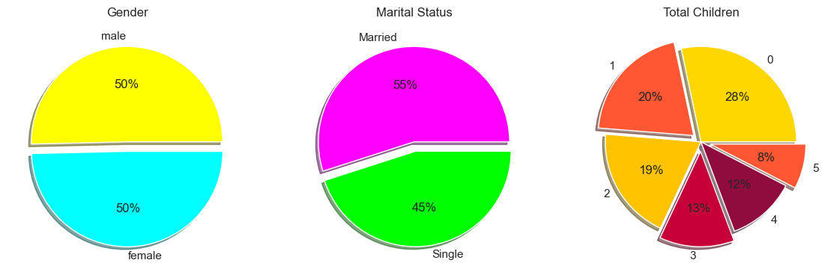
Customer data
Plotting the pie charts to know what is the proportion of customers according to marital status , Gender and how many total children they have
So, there is no difference between the male and female.
There are equal males and female customers but are more married customers with 0 children.

Slide 7
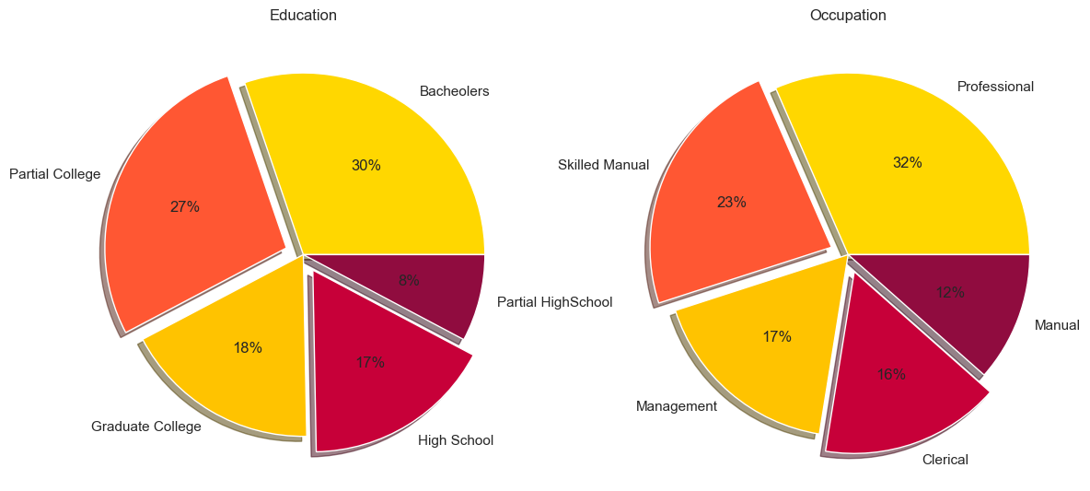
Customers Occupation and Annual income
This shows that the most customers are form professional background and with a bachloer’s education

Slide 8
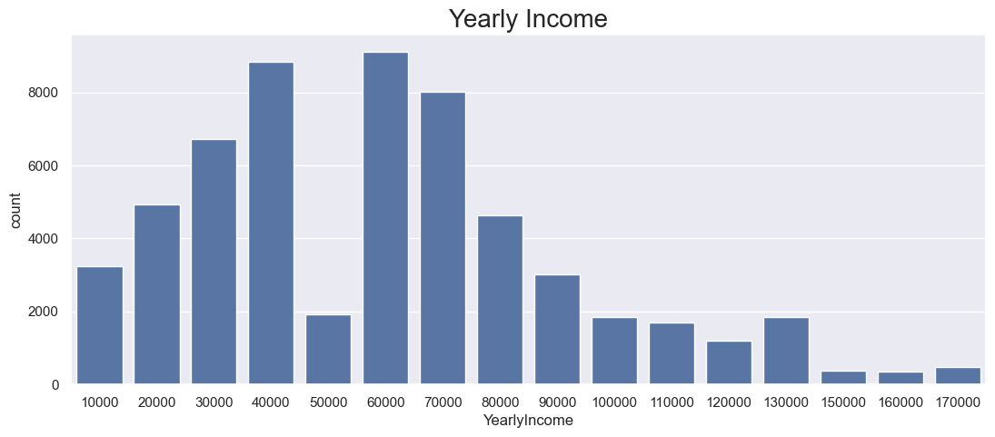
Annual income
The most customers are those who have annual salary between 35000-70000 while customer with 50000 are less customers.

Slide 9
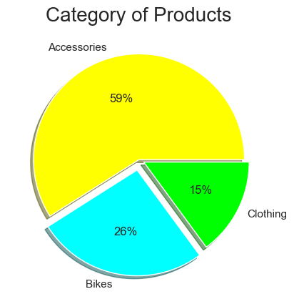
Category of product
This shows that the 59% of the purchase of accessories

Slide 10
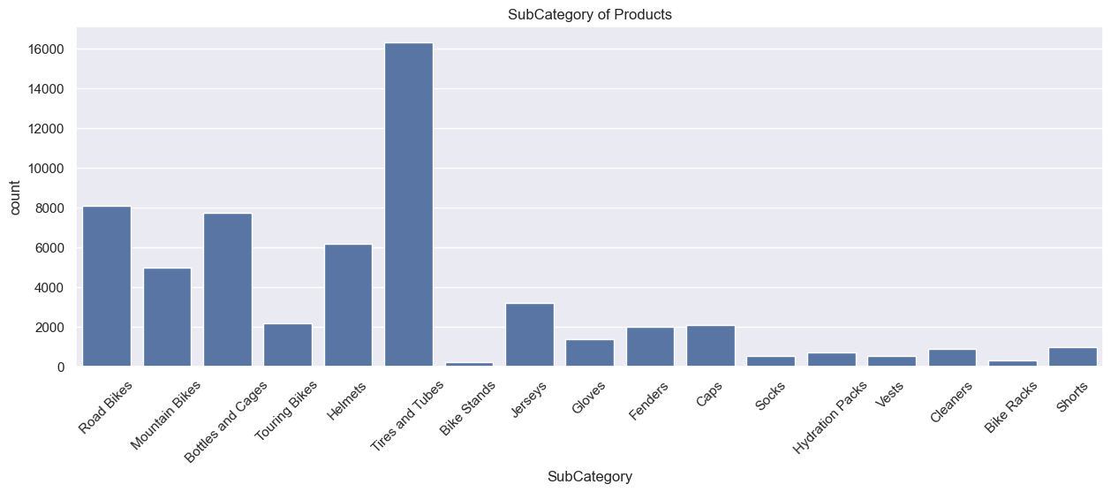
Subcategory of product
Tiers and Tubes are purchases the most followed by the Road Bikes and the lest sold category of product is Bike stands

Slide 11
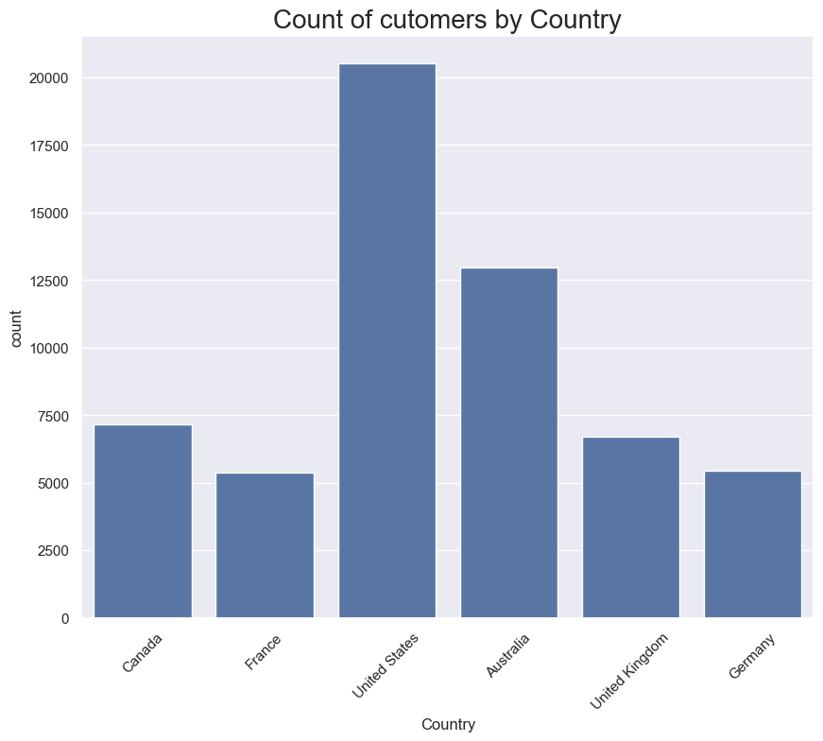
Count of customers by countries
The most number of the customers comes from the U.S
And the least are from France and Germany

Slide 12
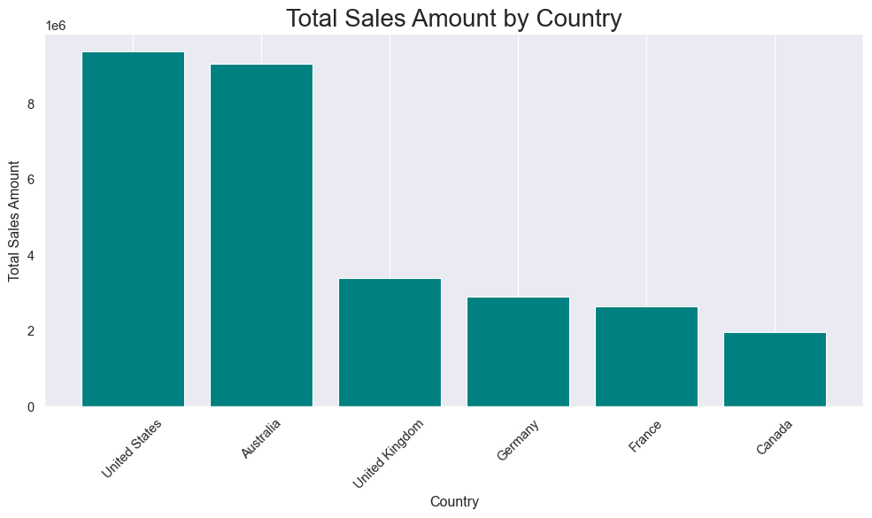
Total Sales amount by country
According to the plot we know that the most amount of sales comes from U.S and though the number of customers in Canada is more the amount is less

Slide 13
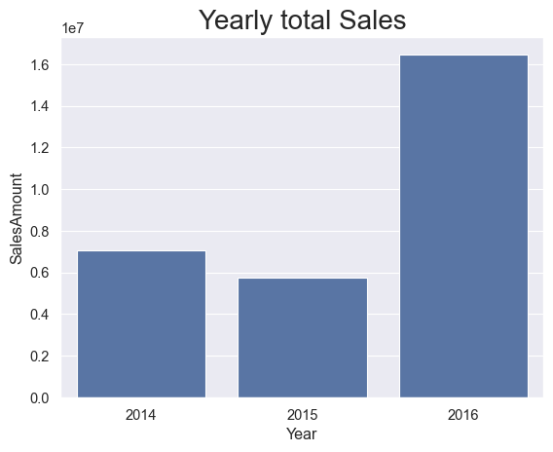
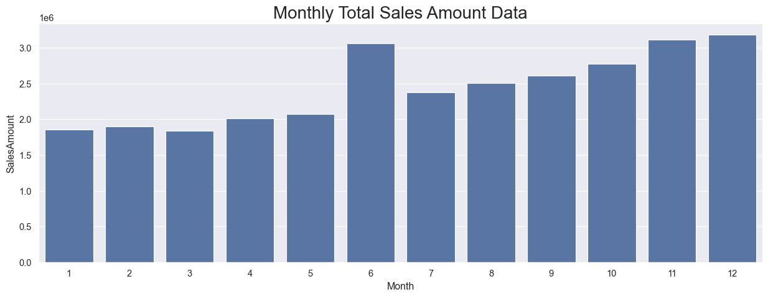
total sales
Yearly Total Sales
Monthly Total Sales
The most amount comes in the month of December , November and June and it gradually increases from Jan to Dec
The most sales are done in the year 2016.

Slide 14
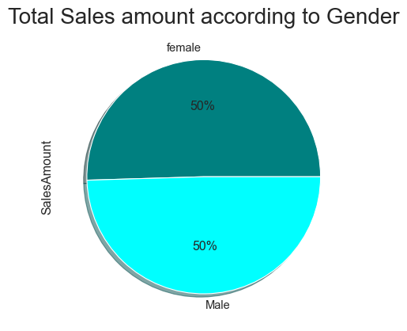
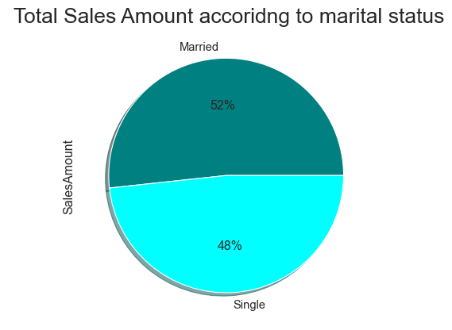
Customers Gender and their Marital status
Gender
Marital status

Slide 15
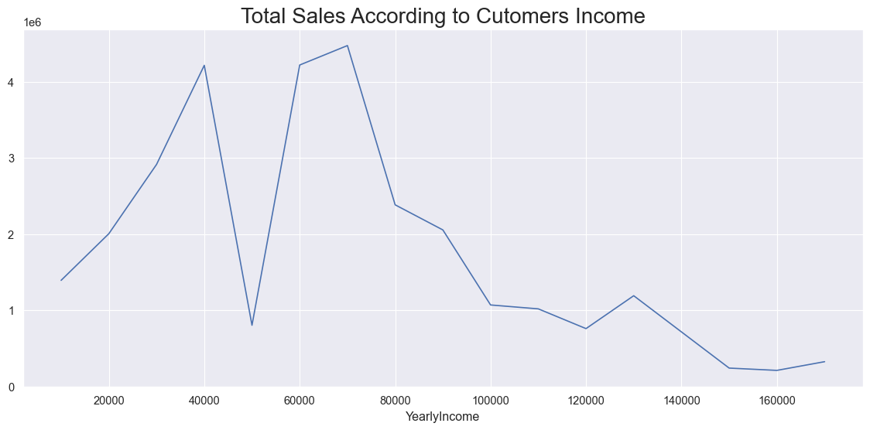
Total sales according to customers income
The above plot shows that the most customers are with a annual income of range between 35000 - 80000 and also the most amount from the same customers

Slide 16
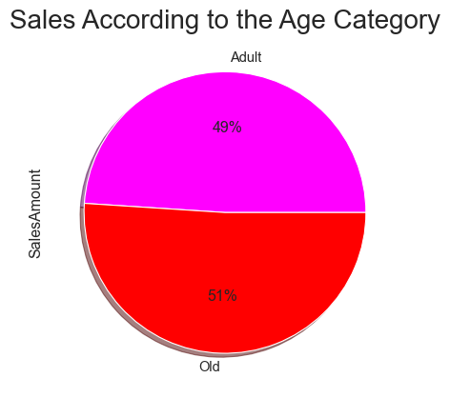
Sales According to Age Category

Slide 17
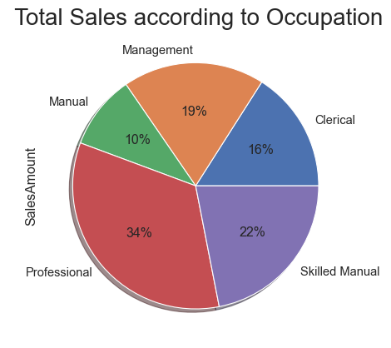
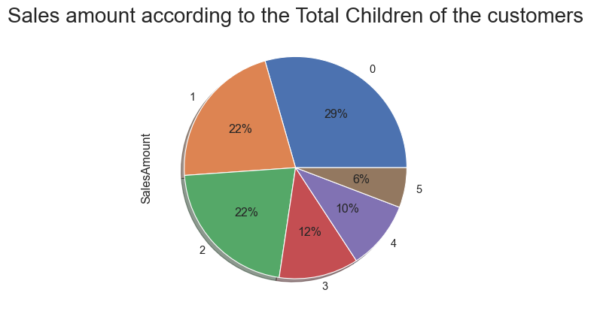
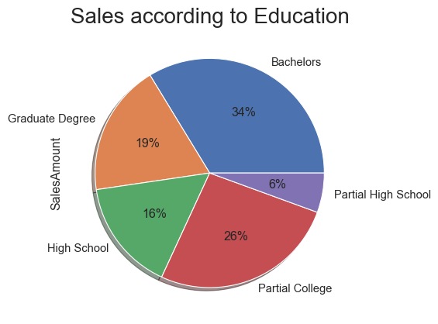
Total Sales According to their Occupation, children, Education

Slide 18
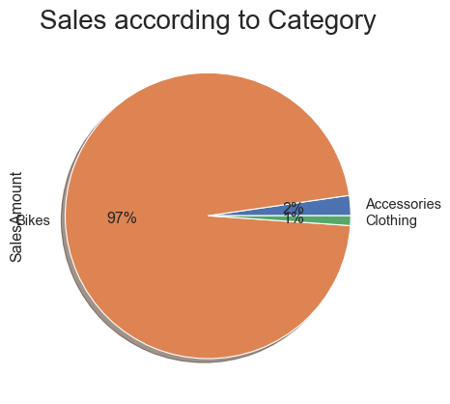
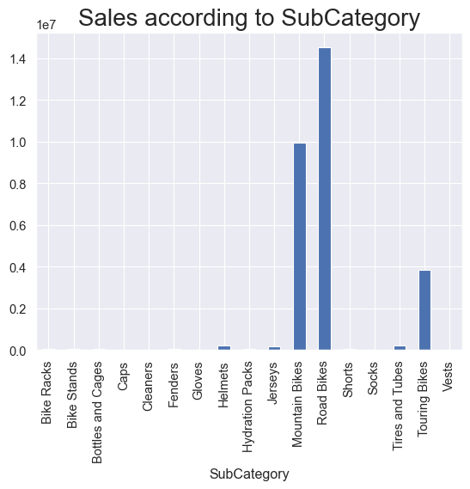
Sales According to category and subcategory

Slide 19
Thank you!

